Slide 1
A cloud software life cycle process (CSLCP) model
Amira A. Alshazly, Mustafa Y. ElNainay, Adel A. El-Zoghabi, Mohamed S. Abougabal
Group Members:
Asif Sharif Akash(ID: 20-42647-1)
Tarek Hossain(ID: 20-43018-1)
Md. Yeasin Rahat(ID: 20-43097-1)

Slide 2
Outline:
Introduction
Objectives
Literature Review
Methodology
Result
Discussion
Conclusion
Reference

Slide 3
Introduction
Cloud computing to SMEs
Software Process Model
Concept of Cloud Software Life Cycle Process (CSLCP)
Process- Capability Maturity Model Integration(CMMI)
Egyptian Software Process Improvement(SPI) model

Slide 4
Objectives
To produce reliable and quality cloud software
Handle the shortcomings of existing ones
Illustrate activities of a software cycle
To help small enterprises develop quality

Slide 5
Literature Review
Two Categories:
Process models of cloud software application
Process models of Software as a Service(SaaS)
Proposed areas, phases and activities

Slide 6
Methodology
Exploration Phase
Alternatives and the decision making Phase
Planning Phase
Analysis Phase
Design Phase
Implementation Phase
Deployment Phase
Maintenance Phase
Retirement Phase

Slide 7
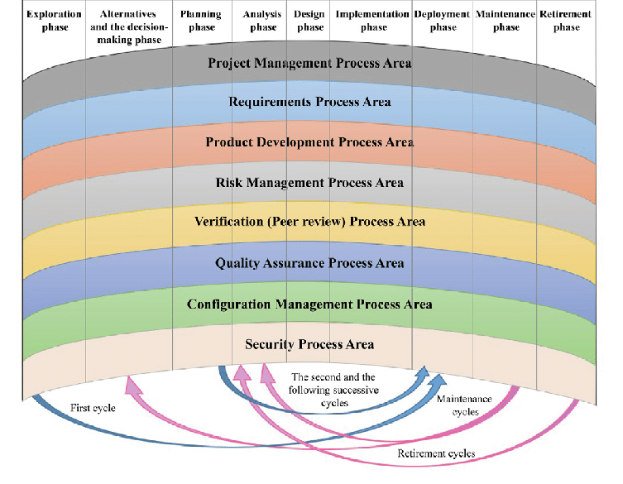
Methodology

Slide 8
Result

Slide 9
Discussion
Considered both software provider and software customer for the artifacts
Cyclic iterative prototyping model
Overcome all the shortcomings
Consideration the risks and challenges of cloud-computing
Extended SPI model for SMEs by adding R, RM and S process areas
Improved quality of the deliverables of the SMEs

Slide 10
Conclusion
Model was proposed, validated and verified
Activities detailed with phases
Result of the process areas
To develop any type of cloud-based software at low cost, good quality

Slide 11
Reference
A. A. Alshazly, M. Y. ElNainay, A. A. El-Zoghabi, and M. S. Abougabal, A conceptual view for an enhanced Cloud Software Life-Cycle Process (CSLCP) Model, accepted in Proceedings of the 2020 9th International Conference on Software and Information Engineering (ICSIE 2020), Cairo, Egypt, November 11-13, 2020, New York, NY, USA: Association for Computing Machinery (ACM).
Link: https://www.researchgate.net/publication/347411160_A_cloud_software_life_cycle_process_CSLCP_model

Slide 12
Thank You

